Slide 1
Discrete Mathematics
Dr. Han Huang
South China University of Technology
1

Slide 2
Chapter 4. Graph
Mathematical Modeling and Application
Section 4.9
2

Slide 3
Contents
1
CPU-Multicore Connection Topology
5
Final Examination Arrangements
2
Computer Network Routing Algorithms
6
Frequency Allocation
3
Bi-level Vehicle Path
7
Index Register
4
Circuit Board Wiring Problems
3

Slide 4
CPU-Multicore Connection Topology
4

Slide 5
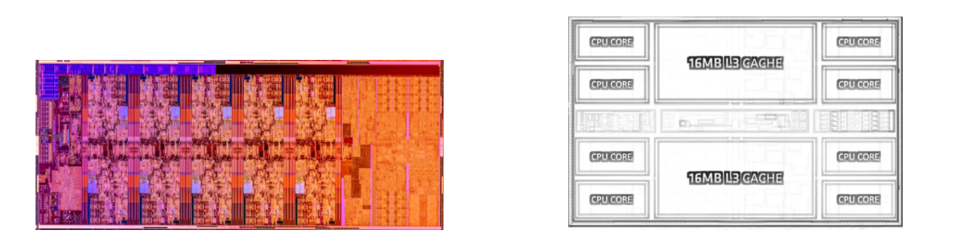
Introduction
The Intel10 generation uses a ring bus, as shown in Figure 4-133a for a 10-core ring bus.
Multicore CPUs for the AMD Zen2 architecture utilize the CCX (Core Complex) and IOD (I/O Die) topologies.
(a) Intel10 generation (b) AMD Ryzen 3000 series

Slide 6
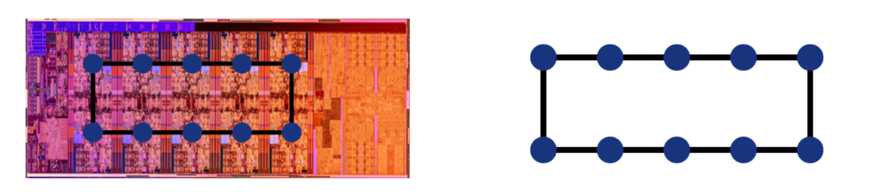
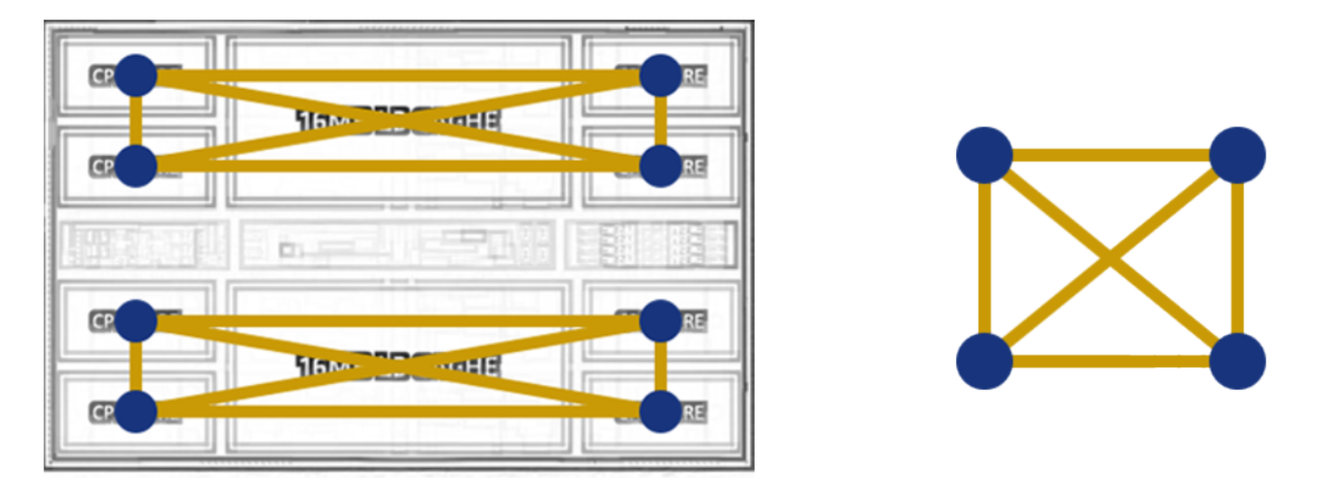
Modeling
Define nodes: Each CPU core is represented as a node in the graph, and there are several cores, i.e. several nodes.
Establish connections: Use undirected edges to create connections between nodes to represent communication paths between cores, each node is connected to its two neighboring nodes to form a closed loop.

Slide 7
Computer Network Routing Algorithms
7

Slide 8
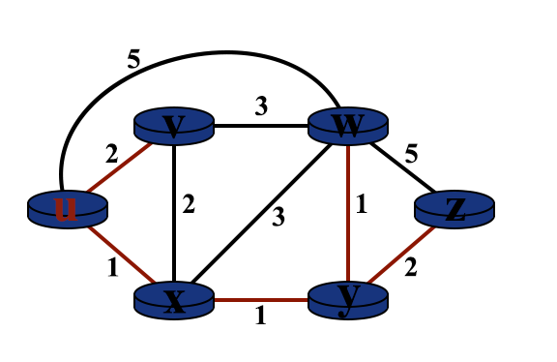
Introduction
In computer networks, end devices and forwarding devices are called nodes and information is transmitted between non-adjacent nodes with the help of forwarding from other nodes. In order to find the shortest path for forwarding information between nodes, Dijkstra's algorithm can be used to calculate the shortest path and get the shortest path tree and forwarding table for each node for efficient transfer of information.
A computer network topology is shown in Figure 4-136, and Figure 4-137 illustrates the process of calculating the shortest path to reach other routers, starting from u

Slide 9
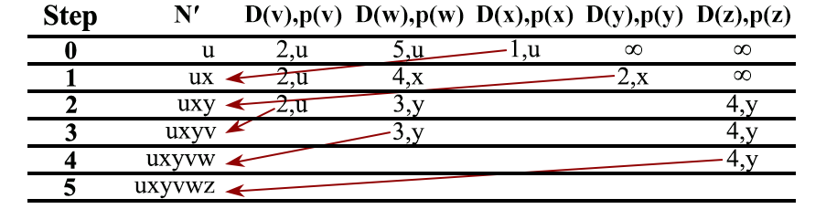
Modeling
The shortest optimal path selection algorithm is a greedy algorithm whose greedy strategy is to select the unvisited node closest to the start node each time, centered on the node, and by continuously selecting the node with the shortest distance and updating the shortest distances of its neighboring nodes until the shortest paths of all nodes are found.

Slide 10
Bi-level Vehicle Path
10

Slide 11
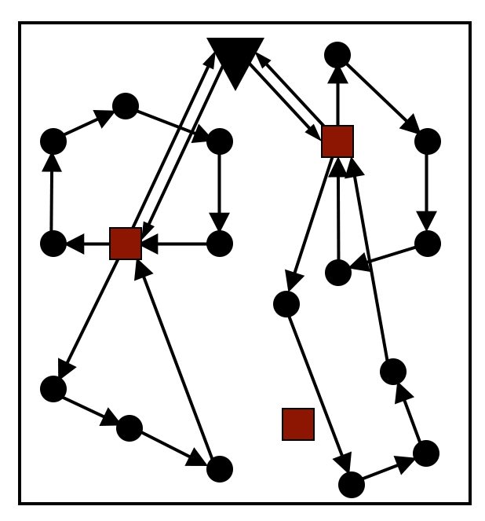
Introduction
Logistics Transportation Given a set of vehicles with capacity constraints, a logistics center, a number of customers with delivery requirements, and a number of travel routes, the goal of the shortest trip is achieved. A first-level path requires a certain number of large trucks to deliver from a warehouse to a transfer station and back to the warehouse, satisfying the conditions that
a transfer station can only be served by one truck and only once,
the number of routes does not exceed the number of trucks, and
the total demand of the transfer stations on each distribution route cannot exceed the load of the trucks. The second level path requires a dispatcher to deliver to a customer from a transfer station and return to the transfer station, satisfying the conditions
a customer can only be served by one dispatcher and only once,
the number of routes does not exceed the number of dispatches, and
the total demand of customers on each delivery route cannot exceed the load of the dispatcher.

Slide 12
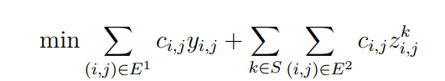
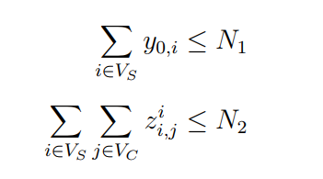
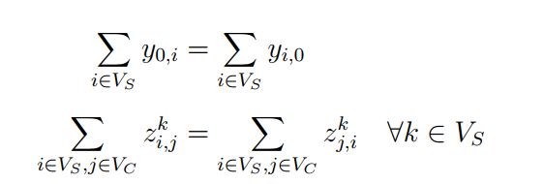
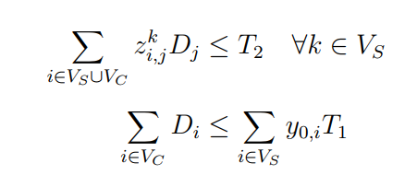
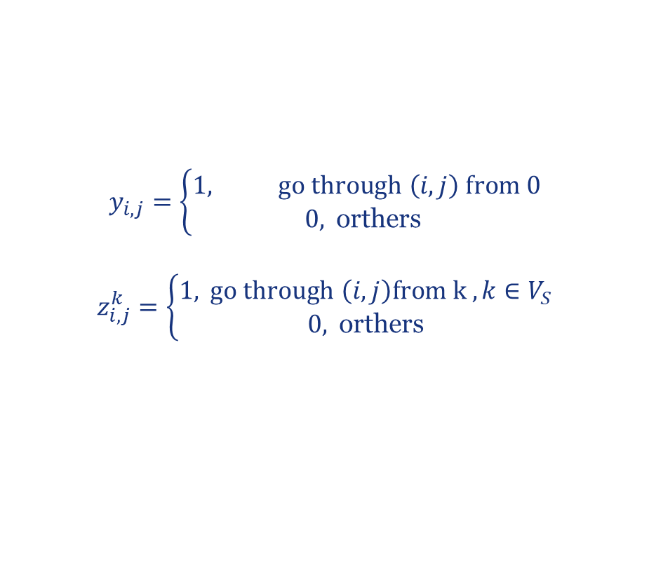
Modeling
$$y_{i,j}=\left\{\begin{matrix}1, \text{go} \text{through} \left(i,j\right) \text{from}\text{ 0} \\ 0, \text{orthers} \end{matrix}\right.$$
$$z_{i,j}^{k}=\left\{\begin{matrix}1, \text{go} \text{through} \left(i,j\right)from k ,k∈V_{S} \\ 0, \text{orthers}\end{matrix}\right.$$
condition(1) and (4) ->
condition(2) and (5) ->
condition(3) and (6) ->
Black triangles denote the main warehouse, red rectangles denote the transfer stations, and purple circles denote the customer nodes. Black arrows denote one-tier paths (large truck deliveries) and purple arrows denote two-tier paths (courier deliveries).

Slide 13
Circuit Board Wiring Problems
13

Slide 14
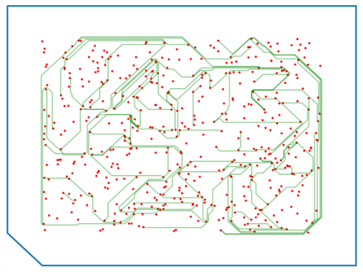
Introduction
connecting the signal lines in a circuit and requires consideration of factors such as the path of the connection, its length, delay, and the integrity of the electrical signal.

Slide 15
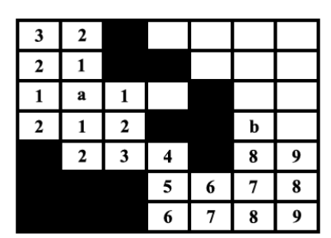
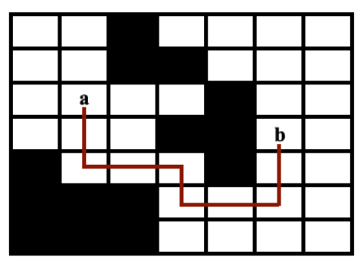
Modeling
Printed circuit boards solve the problem of avoiding crossovers by modeling the wiring area as a maze.
The maze wiring algorithm can be implemented by depth-first search (DFS), breadth-first search (BFS), or A* search.

Slide 16
Final Examination Arrangements
16

Slide 17
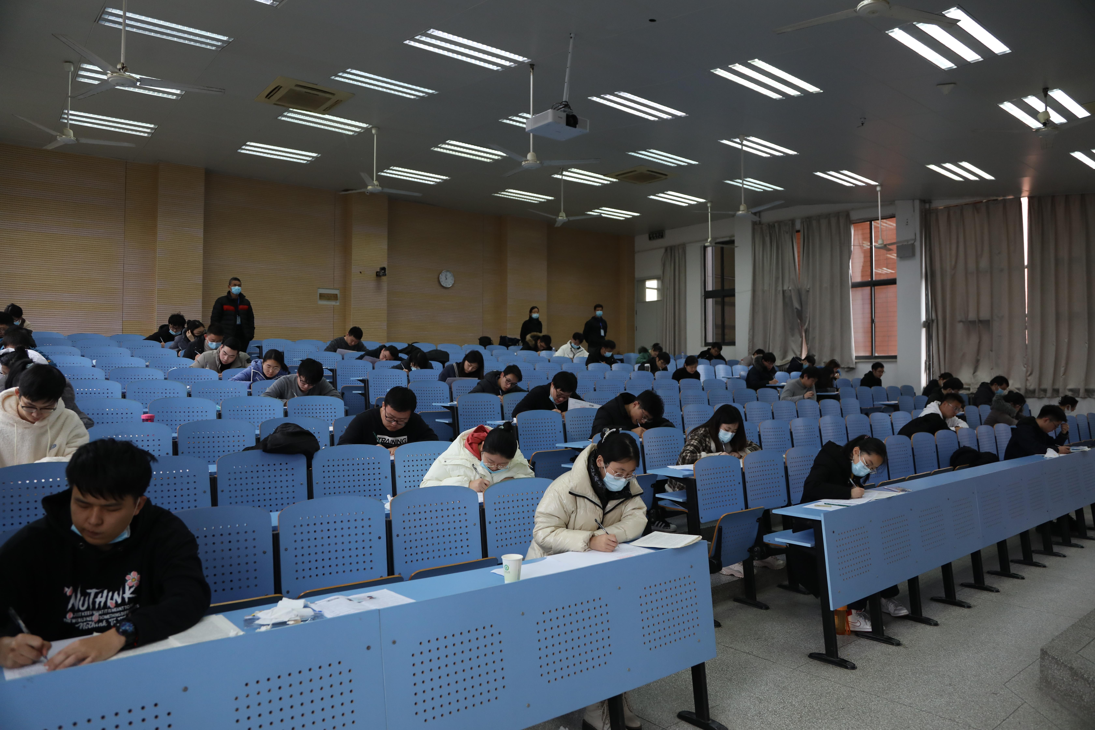
Introduction
Schools need to rationalize and administer final examinations for large numbers of students to ensure smooth running and fairness. The main considerations are the number of students, course schedule, examination time and duration.
However, arranging examinations is laborious, with a long administration cycle and prone to errors.
Assuming that seven examinations are to be arranged, and assuming that the subjects are numbered from 1 to 7, students are expected to sit for examinations in each of the following pairs of subjects: 1 and 2, 1 and 3, 1 and 4, 1 and 7, 2 and 3, 2 and 4, 2 and 5, 2 and 7, 3 and 4, 3 and 6, 3 and 7, 4 and 5, 4 and 6, 5 and 6, 5 and 7, and 6 and 7.

Slide 18
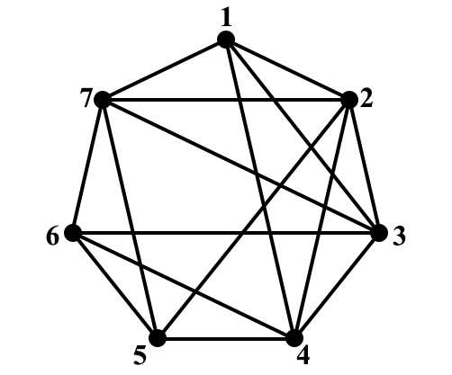
Modeling
Try to analyze the process of graph coloring by graph modeling
?
In practice, more complex algorithms and techniques are usually required to solve the final exam scheduling problem, taking into account more constraints (e.g., exam room capacity, number of students, etc.) and practical limitations.

Slide 19
Frequency Allocation
19

Slide 20

Introduction
Frequency allocation problems are a class of problems that are common in communication systems and involve how to allocate a finite number of frequencies to different users or tasks to avoid stations in close proximity broadcasting on the same channel.
Channels 2 through 13 are assigned to TV stations in North America, avoiding two stations within 150 miles of each other on the same channel. How do I model channel assignments with diagrams?

Slide 21

Modeling
Constructing a graph in this way assigns a vertex to each TV station, and if two TV stations are within 150 miles of each other, the two vertices are linked by an edge, and the channel assignments correspond to the coloring of this graph, where each color represents a different channel
Frequency allocation also makes resource utilization much higher and achieves optimal system performance.

Slide 22
Index Register
22

Slide 23
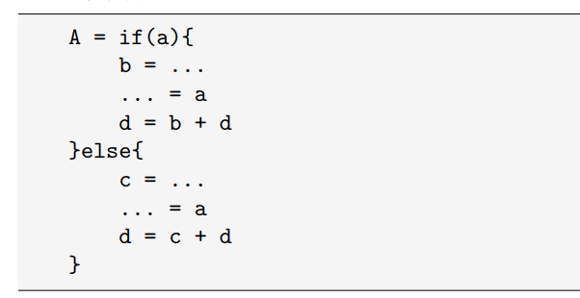
Introduction
In computer architecture, registers are high-speed memories located inside the CPU that are used to store and execute data and instructions during computation.
When two variables exist at the same time, they can not be placed in the same register, registers to store information can not be stored in a unit at the same time to store two pieces of information, at this time the need for two registers to save two pieces of information.

Slide 24
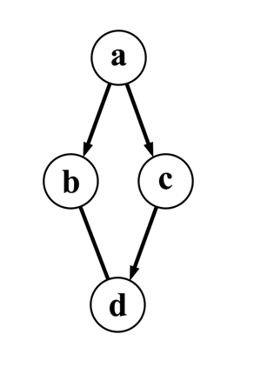
Modeling
The life cycles of a and b, a and c, d and c, and d and b overlap, so a can't be in the same register as bc, and d can't be in the same register as bc, and you can make ad in the same register and bc in the same register.
Graph coloring methods use intersecting graphs to indicate whether the lifetimes of program variables intersect or not, and the problem of assigning registers to variables can be approximated as coloring an intersecting graph: intersecting nodes in an intersecting graph cannot be colored the same way; each color corresponds to a register.

Slide 25
第四章课堂活动
请各位同学参考以上案例，寻找生活中能够用命题逻辑或者推理规则表示的案例，并组队制作PPT。各组的PPT会进行评分，优秀的PPT会推荐在课堂上展示并给予奖励。
PPT需要包括:
1、问题描述
2、模型分析（问题所需的本章知识点）
3、应用效果（问题建模后的公式或推理过程）
4、总结（知识点应用的总结）
各组课下完成PPT，准备时间为一周（12.10之前提交到指定链接）。
25

Slide 26
End of Section 4.9
Click to edit company slogan .
26

